Slide 1
CHAPTER 3 Algorithms
3.1 Algorithms
3.2 The Growth of Functions
3.3 Complexity of Algorithms
1

Slide 2
Homework (Due on March 25)
Sec. 3.1 2, 4
8th、7th

Slide 3
Homework (Due on March25)
Sec. 3.2 8(c), 26(a), 54, 56
7th, 8th

Slide 4
Homework (Due on March 25)
Sec. 3.3 7, 10
7th, 8th
Notes:
https://blog.csdn.net/sinat_21591675/article/details/86521190?depth_1-utm_source=distribute.pc_relevant.none-task&utm_source=distribute.pc_relevant.none-task

Slide 5
3.1 Algorithm
1. Introduction
To solve a given problem:
Setting up the appropriate mathematical model.
Developing an algorithm.
An algorithm is a finite set of precise instructions for performing a computation or for solving a problem.

Slide 6
3.1 Algorithm
〖Example 1〗 Describe an algorithm for finding the maximum (largest) value in a finite sequence of integers.
Solution :
a₁ , a₂ , a₃ ,… , a_{n}
Set the temporary maximum equal to the first integer in the sequence.
Compare the next integer in the sequence to the temporary maximum, and if it is larger than the temporary maximum, set the temporary maximum equal to this integer.
3. Repeat the previous step if there are more integers in the sequence.
4. Stop when there are no integers left in the sequence. The temporary maximum at this point is the largest integer in the sequence.

Slide 7
3.1 Algorithm
Pseudocode: Instructions given in a generic language similar to a computer language such as C++ or Pascal.
A pseudocode description of the algorithm for finding the maximum value in a finite sequence follows.
ALGORITHM 1 Finding the Maximum Element in
a Finite Sequence.
Procedure max( : integers)
max : =
For i : = 2 to n
If max then max
{ max is the largest element}

Slide 8
3.1 Algorithm
Common properties of algorithms:
Input ---- An algorithm has input values from a specified set.
Output ---- From each set of input values, an algorithm produces output values from a specified set.
Definiteness ---- The steps of an algorithm must be defined precisely.
Correctness ---- An algorithm should produce the correct output values for each set of input values.
Finiteness ---- An algorithm should produce the desired output after a finite number of steps for any input in the set.
Effectiveness ---- Each step of an algorithm must be executed exactly and in a finite amount of time.
Generality ---- The procedure should be applicable for all problems of the desired form, not just for a particular set of input values.

Slide 9
3.1 Algorithm
2. Searching Algorithms
The general searching problem:
Locate an element x in a list of distinct elements
,
or determine that it is not in the list.

Slide 10
3.1 Algorithm
(1) Linear Search or sequential search (线性搜索)
ALGORITHM 2 The Linear Search Algorithm.
Procedure linear search (x: integer,
: distinct integers)
i : = 1
While ( )
i : = i+ 1
if then location : = i
else location : = 0
{location is the subscript of term that equals x ,or is 0 if x
is not found}
a
,
a
,
,
a
L
1
2
n

Slide 11
3.1 Algorithm
(2) Binary Search （二分搜索）
〖Example 2〗 To search for 88 in the list
5 13 19 21 37 56 64 75 80 88 92 100.
Solution :
(1) 5 13 19 21 37 56 64 75 80 88 92 100
(2) 64 75 80 88 92 100
(3) 88 92 100
(4) 88 92

Slide 12
3.1 Algorithm
ALGORITHM 3 The Binary Search Algorithm.
Procedure binary search (x: integer,
: increasing integers)
i : = 1{i is left endpoint of search interval }
j: =n { j is right endpoint of search interval }
while i < j
begin
m: =
if then
else
end
if then location : = i
else location : = 0
{location is the subscript of term equal to x ,or 0 if x is
not found }

Slide 13
3.1 Algorithm
3. Some other Algorithms
Sorting: Suppose that we have a list of elements of a set. Sorting is putting these elements into a list in which the elements are in increasing order.
Some typical sorting algorithms:
-- The bubble sort （冒泡排序）
-- The insertion sort （插入排序）
-- The selection sort （选择排序）
-- The binary insertion sort （折半插入排序）
……

Slide 14
3.1 Algorithm
Optimization problem: The goal of such problems is to find a solution to the given problem that either minimizes or maximizes the value of some parameter.
Algorithms that make what seems to be “best” choice at each step are called greedy algorithms.
Some examples,
-- The problem of making n cents change
-- Shortest Path Problems
……

Slide 15
Greedy Algorithms
Optimization problems can often be solved using a greedy algorithm, which makes the “best” choice at each step. Making the “best choice” at each step does not necessarily produce an optimal solution to the overall problem, but in many instances, it does.
After specifying what the “best choice” at each step is, we try to prove that this approach always produces an optimal solution, or find a counterexample to show that it does not.
The greedy approach to solving problems is an example of an algorithmic paradigm, which is a general approach for designing an algorithm. We return to algorithmic paradigms in Section 3.3.

Slide 16
Greedy Algorithms: Making Change
Example: Design a greedy algorithm for making change (in U.S. money) of n cents with the following coins: quarters (25 cents), dimes (10 cents), nickels (5 cents), and pennies (1 cent) , using the least total number of coins.
Idea: At each step choose the coin with the largest possible value that does not exceed the amount of change left.
If n = 67 cents, first choose a quarter leaving 67−25 = 42 cents. Then choose another quarter leaving 42 −25 = 17 cents
Then choose 1 dime, leaving 17 − 10 = 7 cents.
Choose 1 nickel, leaving 7 – 5 = 2 cents.
Choose a penny, leaving one cent. Choose another penny leaving 0 cents.

Slide 17
Greedy Change-Making Algorithm
Solution: Greedy change-making algorithm for n cents. The algorithm works with any coin denominations c₁, c₂, …,c_{r} .
For the example of U.S. currency, we may have quarters, dimes, nickels and pennies, with c₁ = 25, c₂ = 10, c₃ = 5, and c₄ = 1.
procedure change (c₁, c₂, …, c_{r}: values of coins, where c₁> c₂> … > c_{r} ; n: a positive integer)
for i := 1 to r
d_{i} := 0 [d_{i} counts the coins of denomination c_{i}]
while n ≥ c_{i}
d_{i} := d_{i} + 1 [add a coin of denomination c_{i}]
n = n - c_{i}
[d_{i} counts the coins c_{i}]

Slide 18
Proving Optimality for U.S. Coins
Show that the change making algorithm for U.S. coins is optimal.
Lemma 1: If n is a positive integer, then n cents in change using quarters, dimes, nickels, and pennies, using the fewest coins possible has at most 2 dimes, 1 nickel, 4 pennies, and cannot have 2 dimes and a nickel. The total amount of change in dimes, nickels, and pennies must not exceed 24 cents.
Proof: By contradiction
If we had 3 dimes, we could replace them with a quarter and a nickel.
If we had 2 nickels, we could replace them with 1 dime.
If we had 5 pennies, we could replace them with a nickel.
If we had 2 dimes and 1 nickel, we could replace them with a quarter.
The allowable combinations, have a maximum value of 24 cents; 2 dimes and 4 pennies.

Slide 19
Proving Optimality for U.S. Coins
Theorem: The greedy change-making algorithm for U.S. coins produces change using the fewest coins possible.
Proof: By contradiction.
Assume there is a positive integer n such that change can be made for n cents using quarters, dimes, nickels, and pennies, with a fewer total number of coins than given by the algorithm.
Then, q̍ ≤ q where q̍ is the number of quarters used in this optimal way and q is the number of quarters in the greedy algorithm’s solution. But this is not possible by Lemma 1, since the value of the coins other than quarters can not be greater than 24 cents.
Similarly, by Lemma 1, the two algorithms must have the same number of dimes, nickels, and quarters.

Slide 20
Greedy Change-Making Algorithm
Optimality depends on the denominations available.
For U.S. coins, optimality still holds if we add half dollar coins (50 cents) and dollar coins (100 cents).
But if we allow only quarters (25 cents), dimes (10 cents), and pennies (1 cent), the algorithm no longer produces the minimum number of coins.
Consider the example of 31 cents. The optimal number of coins is 4, i.e., 3 dimes and 1 penny. What does the algorithm output?

Slide 21
A failure of the greedy algorithm
In some (fictional) monetary system, “Asiarons” come in 1 Asiaron, 7 Asiaron, and 10 Asiaron coins （亚元）
Using a greedy algorithm to count out 15 Asiarons, you would get
A 10 Asiaron piece
Five 1 Asiaron pieces, for a total of 15 Asiarons
This requires six coins
A better solution would be to use two 7 Asiaron pieces and one 1 Asiaron piece
This only requires three coins
The greedy algorithm results in a solution, but not in an optimal solution

Slide 22
Brute-Force Algorithms
A brute-force algorithm is solved in the most straightforward manner, without taking advantage of any ideas that can make the algorithm more efficient.
Brute-force algorithms we have previously seen are sequential search, bubble sort, and insertion sort.

Slide 23
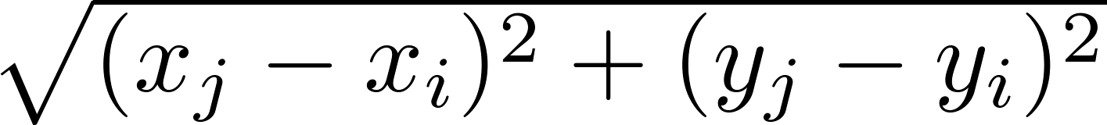
Computing the Closest Pair of Points by Brute-Force
Example: Construct a brute-force algorithm for finding the closest pair of points in a set of n points in the plane and provide a worst-case estimate of the number of arithmetic operations.
Solution: Recall that the distance between (x_{i},y_{i}) and (x_{j}, y_{j}) is . A brute-force algorithm simply computes the distance between all pairs of points and picks the pair with the smallest distance.
Note: There is no need to compute the square root, since the square of the distance between two points is smallest when the distance is smallest.
Continued →

Slide 24
Computing the Closest Pair of Points by Brute-Force （暴力算法）
Algorithm for finding the closest pair in a set of n points.
The algorithm loops through n(n −1)/2 pairs of points, computes the value (x_{j} − x_{i})² + (y_{j} − y_{i})² and compares it with the minimum, etc. So, the algorithm uses Θ(n²) arithmetic and comparison operations.
We will develop an algorithm with O(log n) worst-case complexity in Section 8.3.
procedure closest pair((x₁, y₁), (x₂, y₂), … ,(x_{n}, y_{n}): x_{i}, y_{i} real numbers)
min = ∞
for i := 1 to n
for j := 1 to i
if (x_{j} − x_{i})² + (y_{j} − y_{i})² < min
then min := (x_{j} − x_{i})² + (y_{j} − y_{i})²
closest pair := (x_{i}, y_{i}), (x_{j}, y_{j})
return closest pair

Slide 25
Halting Problem （停机问题）
whether there is a problem that cannot be solved using any procedure (Turning)
Example: Can we develop a procedure that takes as input a computer program along with its input and determines whether the program will eventually halt with that input.
Solution: Proof by contradiction.
Assume that there is such a procedure and call it H(P,I). The procedure H(P,I) takes as input a program P and the input I to P.
H outputs “halt” if it is the case that P will stop when run with input I.
Otherwise, H outputs “loops forever.”

Slide 26
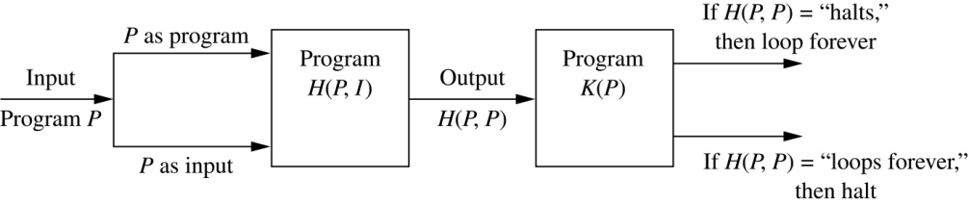
Halting Problem
Since a program is a string of characters, we can call H(P,P). Construct a procedure K(P), which works as follows.
If H(P,P) outputs “loops forever” then K(P) halts.
If H(P,P) outputs “halt” then K(P) goes into an infinite loop printing “ha” on each iteration.

Slide 27
Halting Problem
Now we call K with K as input, i.e. K(K).
If the output of H(K,K) is “loops forever” then K(K) halts. A Contradiction.
If the output of H(K,K) is “halts” then K(K) loops forever. A Contradiction.
Therefore, there can not be a procedure that can decide whether or not an arbitrary program halts. The halting problem is unsolvable.

Slide 28
Halting Problem
Bool DOES-HALT(P, I)
{
if (P will stop when run with input I) //P(I) will stop
return 1
else
return 0
}
Bool SELF-HALT(program)
{ if(DOES-HALT(program, program))
infinite loop
else
halt
}
Then how about
DOES-HALT(SELF-HALT, SELF-HALT)

Slide 29
Homework (Due on March 25)
Sec. 3.1 2, 4
8th、7th

Slide 30
CHAPTER 3 Algorithms
3.1 Algorithms
3.2 The Growth of Functions
3.3 Complexity of Algorithms
30

Slide 31
Big-Theta
3.2 The Growth of Function
f(x)=O(g(x)) only provides an upper bound in terms of g(x) for f(x).
f(x)=Ω(g(x)) only provides a lower bound in terms of g(x) for f(x).
Big-Theta provides both an upper bound and a lower bound for a function in terms of a reference function g(x)

Slide 32
Asymptotic Running Time
3.2 The Growth of Functions
A rough measurement of the running time of an algorithm based on the input size
Gives you the relative rate of growth but not specific time of execution
Allows for comparison of algorithms without implementation
Not hardware specific

Slide 33
Asymptotic Running Time
3.2 The Growth of Functions
Asymptotic running time: the number of operations used by the algorithm as the input size approaches infinity
“Input size” depends on the problem being analyzed
The number of items in the input is often used
- Number of items in a searching algorithm
May use more than one parameter
- Number of edges and vertices in a graph

Slide 34
Growth of Functions- Motivation
3.2 The Growth of Functions
Suppose you are designing a web site to process user data (e.g., financial records).
Suppose algorithm A takes f_{A}(n)=30n+8 operations to process any n records, while algorithm B takes f_{B}(n)=n²+1 operations to process the n records.
Which program do you choose, knowing you’ll want to support millions of records?

Slide 35
Growth of Functions- Motivation
3.2 The Growth of Functions
f_{A}(n)=30n+8
Value of function 
f_{B}(n)=n²+1
Increasing n 

Slide 36
Big-O Notation
3.2 The Growth of Function
【Definition】 Let f and g be functions from Z(or R) to R. We say that “f(x) is O(g(x))” if there are constants C and k such that
|f(x)| ≤ C| g(x)|
whenever x > k.
Witnesses to f(x) is O(g(x))

Slide 37
The function f(x) is O(g(x))
3.2 The Growth of Function
C g(x)
f(x)
g(x)
k
x

Slide 38
Note:
3.2 The Growth of Function
1. Equivalent expressions:
f(x) = O(g(x))
f(x) ∈ O (g(x))
2. The pair C, k satisfiers the definition is never unique. Moreover, if one such pair exists, there are infinitely many such pairs.
3. When f(x) is O(g(x)) , and h(x) is a function that has larger absolute values than g(x) does for sufficiently large values of x, it follows that f(x) is O(h(x)) .

Slide 39
O(n³)
f(n) = 12n² + n
O(n²)
f(n) = n^{2.5}
Faster Growing
f(n) = n^{3.1} – n²

Slide 40
3.2 The Growth of Function
〖Example 1〗 Show that f(x) = x² + 2x + 1 is O(x²).
Solution：
1) f(x) = x² + 2x + 1
For all x > 1
≤ x² + 2x² + 1
≤ x² + 2x² + x²
For all x > 1
= 4x²
= Cx²
= Cg(x)
We have: C = 4, k = 1, g(x) = x²
f(x) is O(x²)
2) 0 ≤ x² + 2x + 1 ≤ x² + x² + x² = 3x² whenever x>2
3) x² is O(x²+2x+1)
Note: Two functions f(x) and g(x) that satisfy both of these big-O relationships are of the same order.

Slide 41
3.2 The Growth of Function
〖Example 2〗 Show that 7x² is O(x³). Is it also true x³ is O(7x²)?
Solution：
1) Note that when x>7, we have 7x² <x³. Consequently, we can take C=1, and k=7, and to establish the relation 7x² is O(x³).
2) x³≤ C(7x²)
x≤ 7C
Note that no C exists for which x≤ 7C for all x>k.

Slide 42
Some Important Big-O Results
3.2 The Growth of Function
【Theorem】 Let f(x) = a_{n}x^{n} + a_{n-1}x^{n-1} +…+ a₁x+ a₀,where a₀, a₁ ,…, a_{n} are real numbers. Then f(x) is O(x^{n}).
Proof:
Using the triangle inequality, if x>1 we have
It follows that
where whenever x>1

Slide 43
Some Important Functions
3.2 The Growth of Function
Complexity Term
O(1) constant
O(log n) logarithmic
O(n) linear
O(n log n) n log n
O(n^{b}) polynomial
O(b^{n}) b > 1 exponential
O(n!) factorial

Slide 44
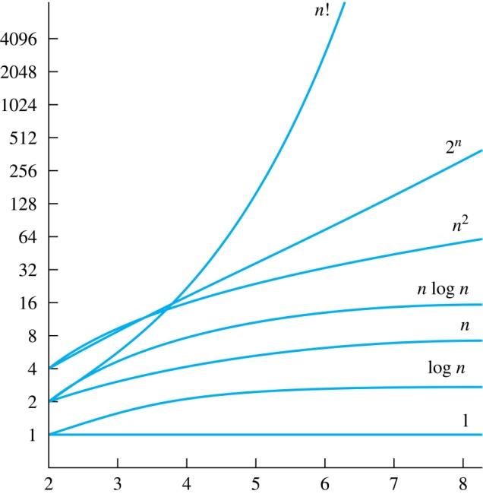
Growth of Some Common Functions
3.2 The Growth of Function

Slide 45
Growth of Combinations of Functions
3.2 The Growth of Function
(1) Addition of functions
If f₁(x) is O(g₁(x)) and f₂(x) is O(g₂(x)),
then (f₁ + f₂)(x) is O(max(g₁(x),g₂(x))).
〖Example 4〗 What is the complexity of the function n² + log(n!) ?
Solution:
n² = O(n²)
log(n!) = O(n log n)
Since O(n²) > O(n log n),
n² +n log(n!) = O(n²)

Slide 46
Growth of Combinations of Functions
3.2 The Growth of Function
(2) Multiplication of functions
If f₁(x) is O(g₁(x)) and f₂(x) is O(g₂(x)),
then (f₁f₂)(x) is O(g₁(x)g₂(x)).
〖Example 5〗 What is the complexity of the function 3nlog(n!) ?
Solution:
3n = O(n)
log(n!) = O(n log n)
3nlog(n!) = O(n ×n log n) = O(n²log n)

Slide 47
Ordering Functions by Order of Growth
3.2 The Growth of Function
〖Example 6〗Put the functions below in order so that each function is big-O of the next function on the list.
f₁(n) = (1.5)^{n} f₂(n) = 8n³+17n² +11 1
f₃(n) = (log n )² f₄(n) = 2^{n}
f₅(n) = log (log n) f₆(n) = n² (log n)³
f₇(n) = 2^{n} (n² +1) f₈(n) = n³+ n(log n)²
f₉(n) = 10000, f₁₀(n) = n!

Slide 48
Big-Omega
3.2 The Growth of Function
f(x)=O(g(x)) only provides an upper bound in terms of g(x) for f(x).
What do we do for a lower bound?
Big-Omega provides a lower bound for a function within a constant factor.
【Definition】 Let f and g be functions from Z (or R) to R. We say that “f(x) is Ω(g(x))” if there are constants C and k such that
| f(x)| ≥ C| g(x)|
whenever x> k.

Slide 49
Big-Omega
3.2 The Growth of Function
f(x)
Cg(x)
g(x)
k
x

Slide 50
3.2 The Growth of Function
〖Example 6〗 Show that f(x) = 8x³ + 5x² + 7 is Ω(x³).
Solution:
f(x) = 8x³ + 5x² + 7
≥ 8x³
For all x > 1
= Cx³
= Cg(x)
We have: C = 8, k = 1, g(x) = x³
f(x) is Ω(x³)

Slide 51
Big-Theta
3.2 The Growth of Function
f(x)=O(g(x)) only provides an upper bound in terms of g(x) for f(x).
f(x)=Ω(g(x)) only provides a lower bound in terms of g(x) for f(x).
Big-Theta provides both an upper bound and a lower bound for a function in terms of a reference function g(x)

Slide 52
Big-Theta
3.2 The Growth of Function
【Definition】 Let f and g be functions from Z (or R) to R. We say that “f(x) is Θ(g(x))” if “f(x) is O(g(x))” and “f(x) is Ω(g(x))”, i.e., there are constants C₁, C₂, and k such that
0 ≤ C₁g(x) ≤ f(x) ≤ C₂g(x)
whenever x > k.
f(x) is Θ(g(x)) is read as:
“f(x) is big-Theta of g(x)”
“f(x) is of order g(x)”

Slide 53
Big-Theta
3.2 The Growth of Function
C₂g(x)
f(x)
C₁g(x)
k
x

Slide 54
3.2 The Growth of Function
〖Example 7〗 Show that f(x) = 3x² + 8xlogx is Θ(x²).
Solution:
f(x) = 3x² + 8xlogx
≤ 3x² + 8x²
For x >1
f(x) is O(x²)
= 11x²
= C₂x²
= C₂g(x)
f(x) = 3x² + 8xlogx
≥ 3x²
For x > 1
f(x) is Ω(x²)
= C₁x²
= C₁g(x)
We have: C₁ = 3, C₂ = 11, k = 1, g(x) = x²
f(x) is Θ(x²)

Slide 55
Homework (Due on March25)
Sec. 3.2 8(c), 26(a), 54, 56
7th, 8th

Slide 56
CHAPTER 3 Algorithms
3.1 Algorithms
3.2 The Growth of Function (函数的增长率)
3.3 Complexity of Algorithms
56

Slide 57
The Complexity of Algorithms
Given an algorithm, how efficient is this algorithm for solving a problem given input of a particular size? To answer this question, we ask:
How much time does this algorithm use to solve a problem?
How much computer memory does this algorithm use to solve a problem?
When we analyze the time the algorithm uses to solve the problem given input of a particular size, we are studying the time complexity of the algorithm.
When we analyze the computer memory the algorithm uses to solve the problem given input of a particular size, we are studying the space complexity of the algorithm.

Slide 58
Different types of analysis
3.3 Complexity of Algorithms
Worst-case analysis
- Maximum number of operations
- Is a guarantee over all inputs of a given size
Best-case analysis
- Minimum number of operations
- Not very practical
Average-case analysis
- Average number of operations assuming an input probability distribution
- An average over all the possible inputs of a given size
- Can be complicated

Slide 59
3.3 Complexity of Algorithms
Complexity Analysis of Algorithms
ALGORITHM 1 Finding the Maximum Element in
a Finite Sequence.
Procedure max( : integers)
max : =
For i : = 2 to n
If max then max
{ max is the largest element}
〖Example 1〗Describe the time complexity of algorithm for finding the maximum element in a set.
Solution: Count the number of comparisons.
The max < a_{i} comparison is made n − 1 times.
Each time i is incremented, a test is made to see if i ≤ n.
One last comparison determines that i > n.
Exactly 2(n − 1) + 1 = 2n − 1 comparisons are made.
Hence, the time complexity of the algorithm is Θ(n).

Slide 60
3.3 Complexity of Algorithms
ALGORITHM 2 The Linear Search Algorithm.
Procedure linear search (x: integer, : distinct integers)
i : = 1
While ( )
i : = i+ 1
if then location : = i
else location : = 0
{location is the subscript of term that equals x ,or is 0 if x
is not found}
a
,
a
,
L
,
a
1
2
n
〖Example 2〗Describe the time complexity of linear search algorithm.
Solution: Count the number of comparisons.
At each step two comparisons are made; i ≤ n and x ≠ ai .
To end the loop, one comparison i ≤ n is made.
After the loop, one more i ≤ n comparison is made.
If x = ai , 2i + 1 comparisons are used. If x is not on the list, 2n + 1 comparisons are made and then an additional comparison is used to exit the loop. So, in the worst case 2n + 2 comparisons are made. Hence, the complexity is Θ(n).

Slide 61
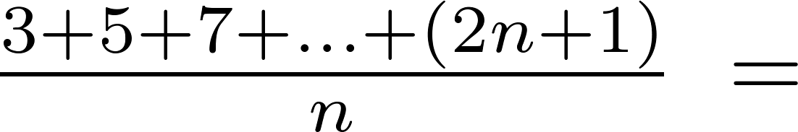
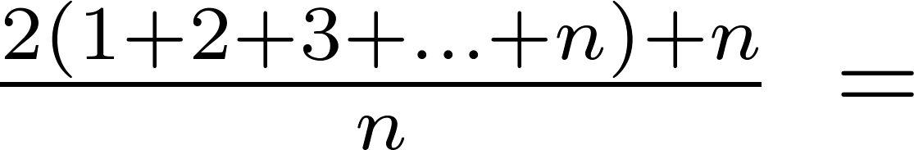
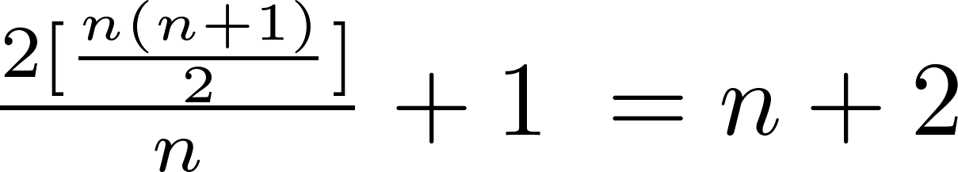
Average-Case Complexity of Linear Search
Example: Describe the average case performance of the linear search algorithm. (Although usually it is very difficult to determine average-case complexity, it is easy for linear search.)
Solution: Assume the element is in the list and that the possible positions are equally likely. By the argument on the previous slide, if x = a_{i} , the number of comparisons is 2i + 1.
Hence, the average-case complexity of linear search is Θ(n).

Slide 62
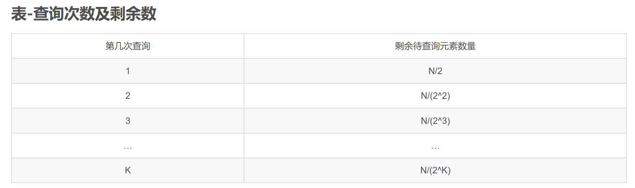
Worst-Case Complexity of Binary Search
Example: Describe the time complexity of binary search in terms of the number of comparisons used.
procedure binary search(x: integer, a₁,a₂,…, a_{n}: increasing integers)
i := 1 {i is the left endpoint of interval}
j := n {j is right endpoint of interval}
while i < j
m := ⌊(i + j)/2⌋
if x > a_{m} then i := m + 1
else j := m
if x = a_{i} then location := i
else location := 0
return location{location is the subscript i of the term a_{i} equal to x, or 0 if x is not found}

Slide 63
Worst-Case Complexity of Binary Search
Example: Describe the time complexity of binary search in terms of the number of comparisons used.
procedure binary search(x: integer, a₁,a₂,…, a_{n}: increasing integers)
i := 1 {i is the left endpoint of interval}
j := n {j is right endpoint of interval}
while i < j
m := ⌊(i + j)/2⌋
if x > a_{m} then i := m + 1
else j := m
if x = a_{i} then location := i
else location := 0
return location{location is the subscript i of the term a_{i} equal to x, or 0 if x is not found}
Solution: Assume (for simplicity) n = 2^{k} elements. Note that k = log n.
Two comparisons are made at each stage; i < j, and x > a_{m} .
At the first iteration the size of the list is 2^{k} and after the first iteration it is 2^{k-1}. Then 2^{k-2} and so on until the size of the list is 2¹ = 2.
At the last step, a comparison tells us that the size of the list is the size is 2⁰ = 1 and the element is compared with the single remaining element.
Hence, at most 2k + 2 = 2 log n + 2 comparisons are made.
Therefore, the time complexity is Θ (log n), better than linear search.

Slide 64

Matrix Multiplication Algorithm
The definition for matrix multiplication can be expressed as an algorithm; C = A B where C is an m n matrix that is the product of the m k matrix A and the k n matrix B.
This algorithm carries out matrix multiplication based on its definition.
procedure matrix multiplication(A,B: matrices)
for i := 1 to m
for j := 1 to n
c_{ij} := 0
for q := 1 to k
c_{ij} := c_{ij} + a_{iq} b_{qj}
return C{C = [c_{ij}] is the product of A and B}

Slide 65
Complexity of Matrix Multiplication
Example: How many additions of integers and multiplications of integers are used by the matrix multiplication algorithm to multiply two n X n matrices.
Solution: There are n² entries in the product. Finding each entry requires n multiplications and n − 1 additions. Hence, n³ multiplications and n²(n − 1) additions are used.
Hence, the complexity of matrix multiplication is O(n³).

Slide 66
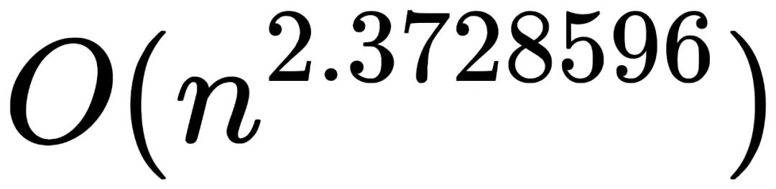
Complexity of Matrix Multiplication
Example: How many additions of integers and multiplications of integers are used by the matrix multiplication algorithm to multiply two n X n matrices.
Solution: There are n² entries in the product. Finding each entry requires n multiplications and n − 1 additions. Hence, n³ multiplications and n²(n − 1) additions are used.
Hence, the complexity of matrix multiplication is O(n³).
n阶矩阵乘法最优解的时间复杂度再次被突破，达到了

Slide 67
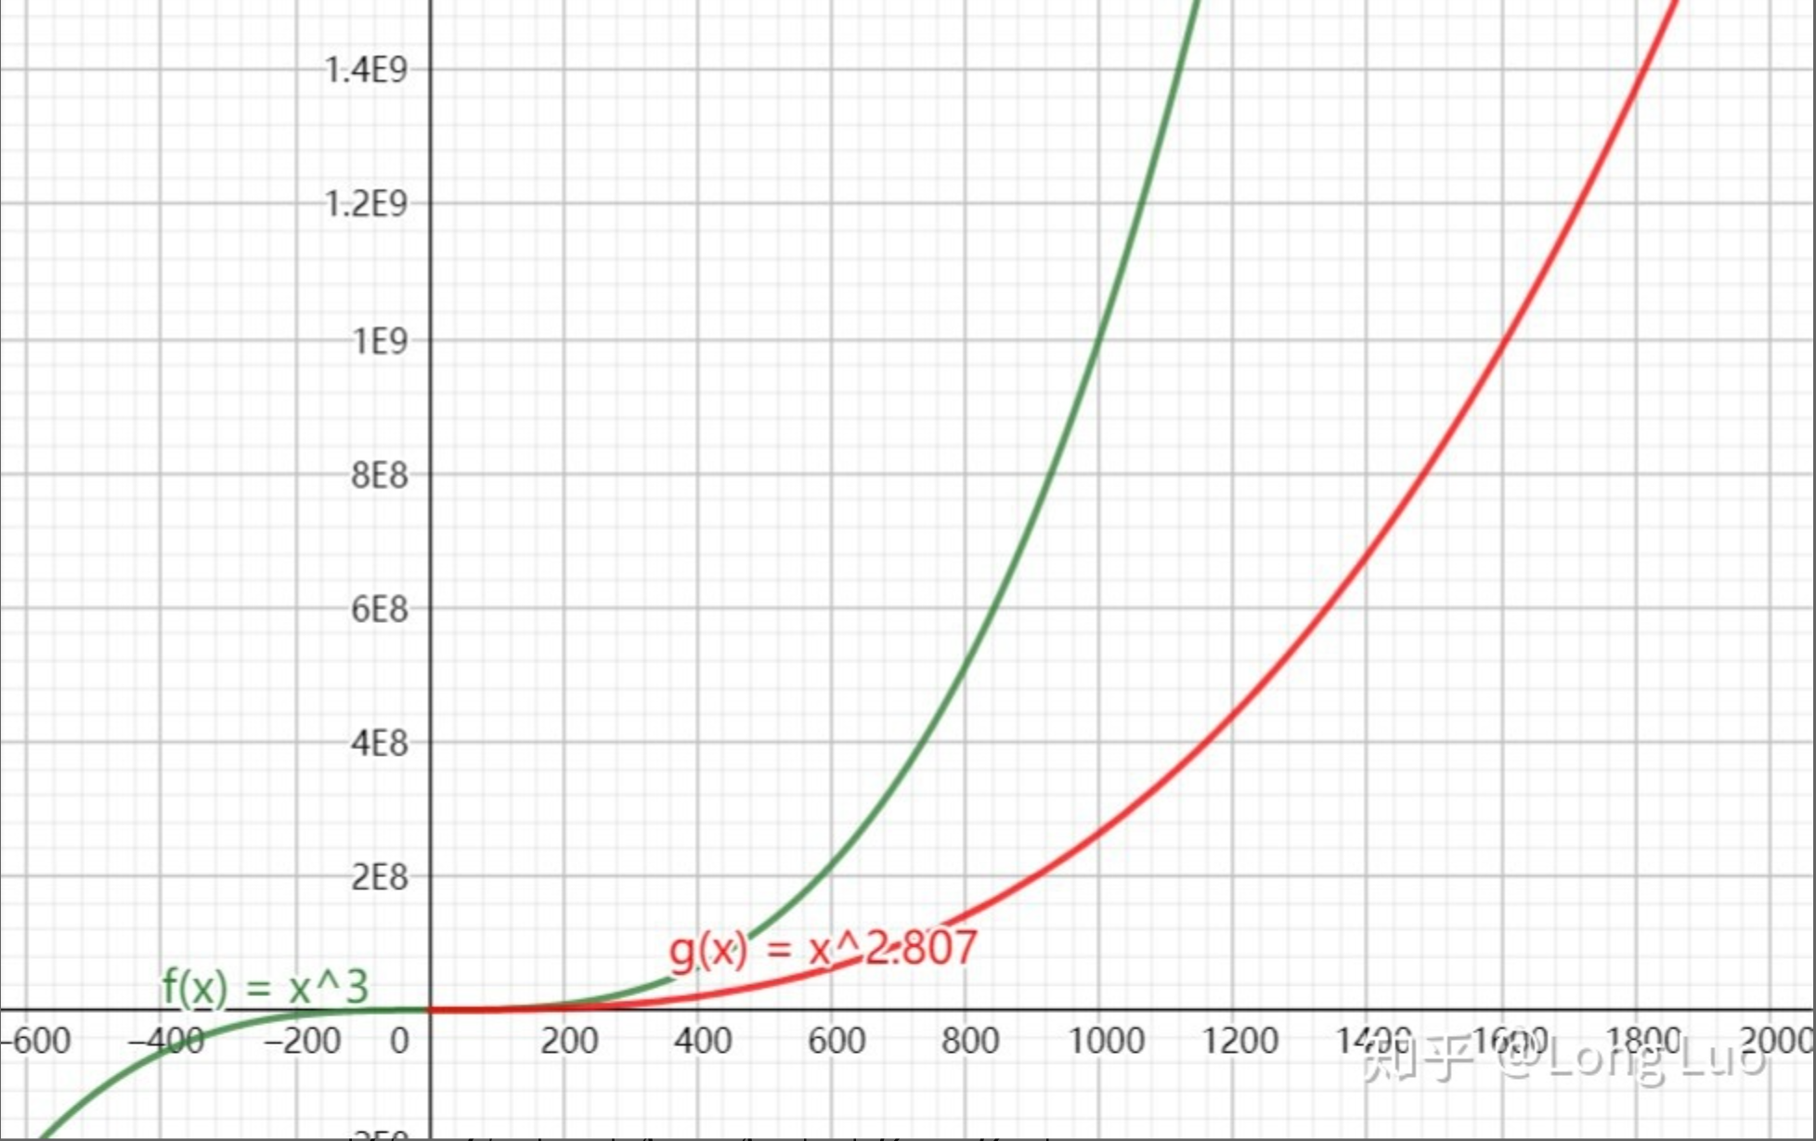
Complexity of Matrix Multiplication
Strassen算法
Coppersmith-Winograd方法, 2.375

Slide 68
Example
以计算 nXn 阶行列式为例子。
如果我们用行列式定义去计算，其计算复杂度为 O(n•n!)
如果我们通过行消元将行列式化上三角行列计算，其计算复杂度为 O(n⁴)
如果 n= 50,采用第一种方法所需要计算的乘法次数 1.5X10^{65，}第二种方法所需要的乘法次数为6X10⁶，如果用一台计算速度是每秒可执行1000亿次乘法的计算机计算，其计算时间分别为5x10⁴⁶年及6x10⁻⁵秒

Slide 69
* Understanding the complexity of algorithm
3.3 Complexity of Algorithms
Tractable（易解）: A problem is solvable using an algorithm with polynomial worst-case complexity.
Intractable（难解）: A problem cannot be solved using an algorithm with worst-case polynomial time complexity.
Solvable（可解）:
Unsolvable（不可解）: Some problems even exist for which it can be shown that no algorithm exists for solving them.
Halting problem: given a program and an input to the program, whether the program will eventually halt when run with that input.
K = { (i, x) | program i will eventually halt if run with input x}

Slide 70
* Understanding the complexity of algorithm
3.3 Complexity of Algorithms
Class P: tractable problems
Class NP (nondeterministic polynomial time): Solution can be checked in polynomial time. But no polynomial time algorithm has been found for finding a solution to problems in this class.
NP-complete: an important class of problems with the property that if any of these problems can be solved by a polynomial worst-case time algorithm, then all can be solved by polynomial worst-case time algorithms.
The satisfiability problem: the problem of determining if the variables of a given Boolean formula can be assigned in such a way as to make the formula evaluate to TRUE

Slide 71
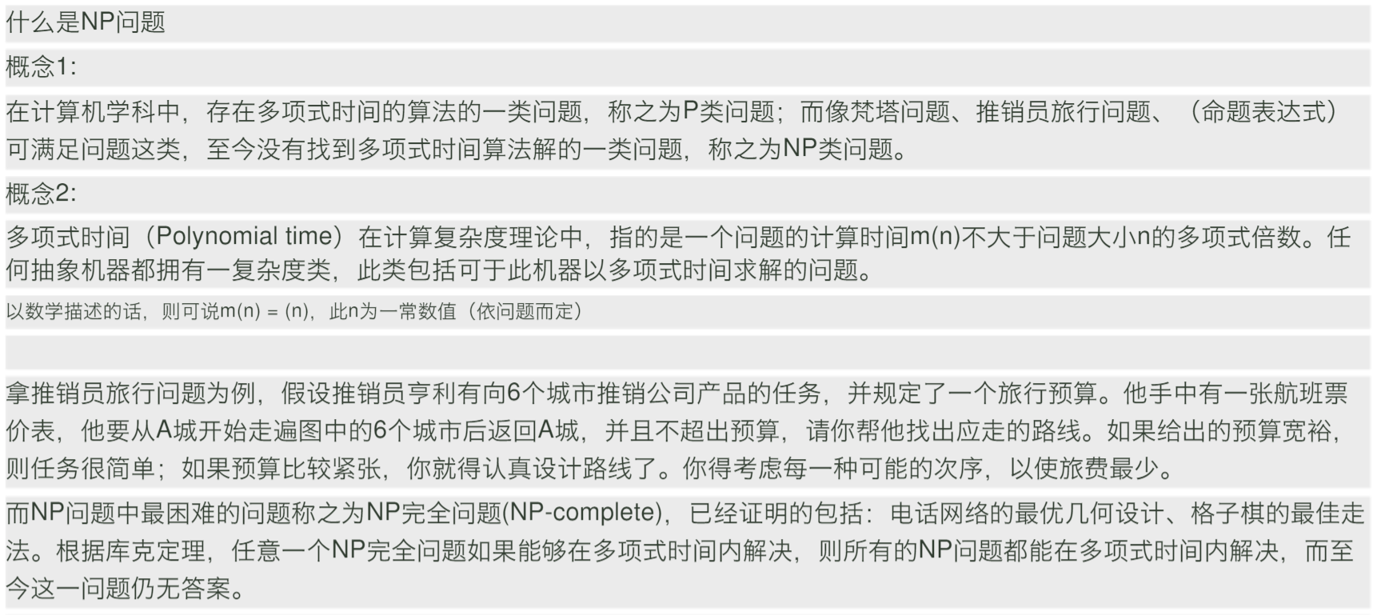
P就是能在多项式时间内解决的问题，NP就是能在多项式时间验证答案正确与否的问题。
P是否等于NP实质上就是在问，如果对于一个问题我能在多项式时间内验证其答案的正确性，那么我是否能在多项式时间内解决它？
NPC问题：NP中的某些问题的复杂性与整个类的复杂性相关联.这些问题中任何一个如果存在多项式时间的算法,那么所有NP问题都是多项式时间可解的.这些问题被称为NP-完全问题(NPC问题)。

Slide 72
Homework (Due on March 25)
Sec. 3.3 7, 10
7th, 8th
Notes:
https://blog.csdn.net/sinat_21591675/article/details/86521190?depth_1-utm_source=distribute.pc_relevant.none-task&utm_source=distribute.pc_relevant.none-task

Slide 73
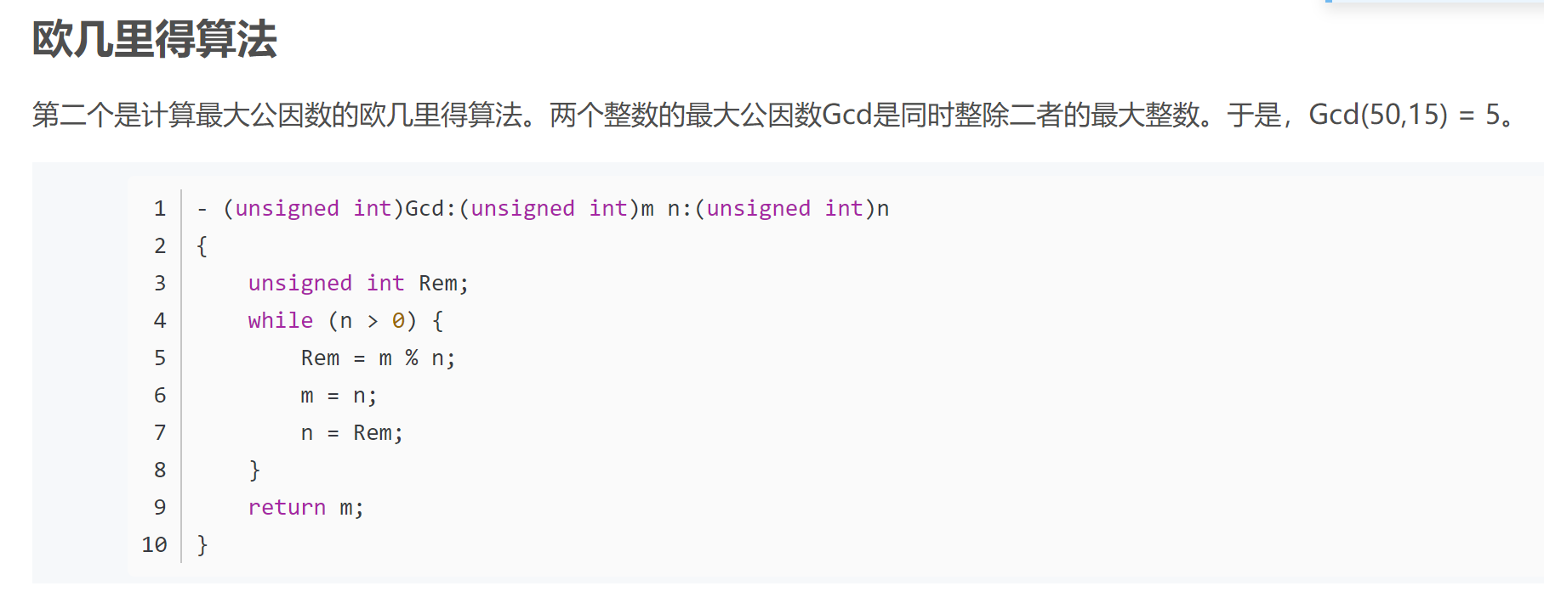
复杂度分析补充
对数复杂度
两次迭代最多是原始数据的一半，迭代次数至多是2logN。

Slide 74
复杂度分析补充
通常都是
有没有

Slide 75
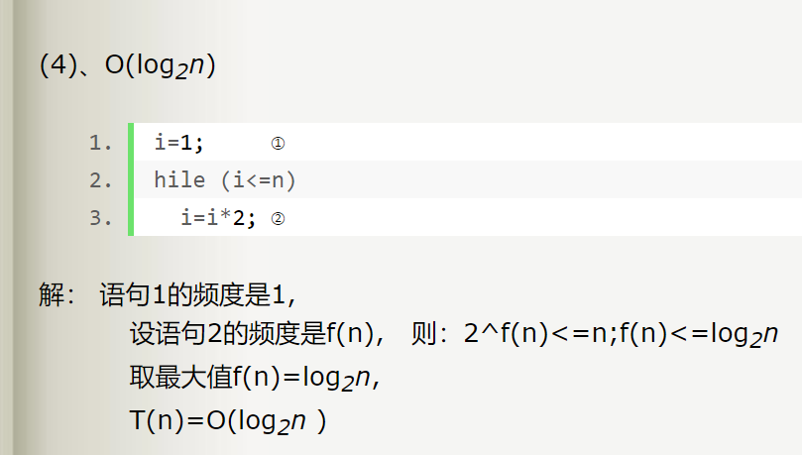
复杂度分析补充
对数复杂度

Slide 76
线性方程组求解：
Ax=b
1、Cramer’s rule
2、Gauss elimination

Slide 77
Boolean Product Algorithm
The definition of Boolean product of zero-one matrices can also be converted to an algorithm.
procedure Boolean product(A,B: zero-one matrices)
for i := 1 to m
for j := 1 to n
c_{ij} := 0
for q := 1 to k
c_{ij} := c_{ij} ∨ (a_{iq} ∧ b_{qj})
return C{C = [c_{ij}] is the Boolean product of A and B}

Slide 78
Complexity of Boolean Product Algorithm
Example: How many bit operations are used to find A ⊙ B, where A and B are n n zero-one matrices?
Solution: There are n² entries in the A ⊙ B. A total of n Ors and n ANDs are used to find each entry. Hence, each entry takes 2n bit operations. A total of 2n³ operations are used.
Therefore the complexity is O(n³)

